Slide 1
American or English Foxhound Key
Ponderosa FFA Vet Science Team

Slide 2
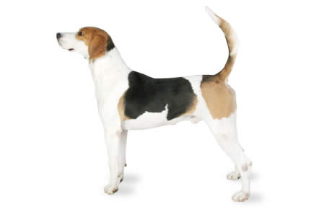
1. English Foxhound

Slide 3
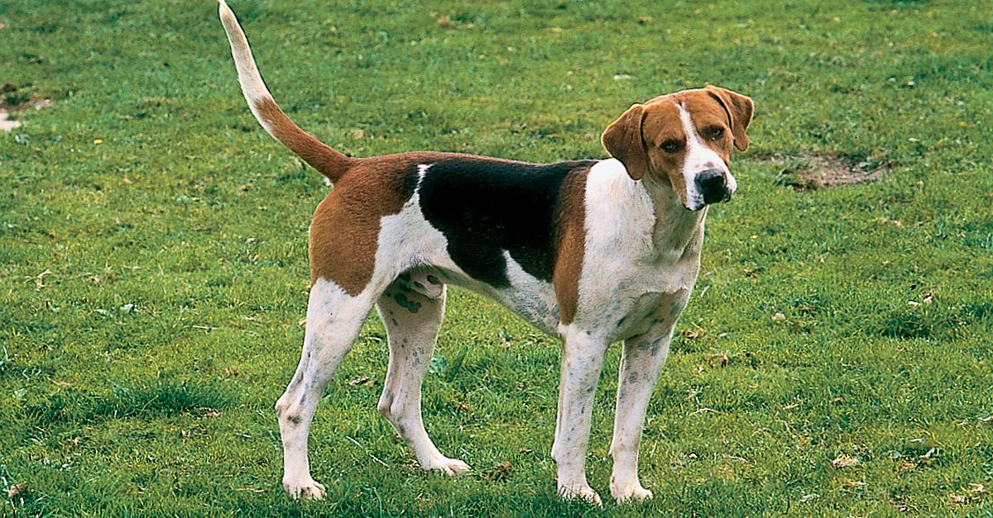
2. English Foxhound

Slide 4
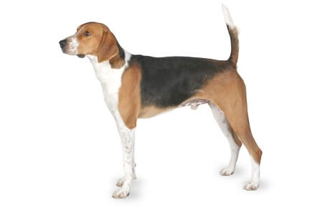
3. American Foxhound

Slide 5
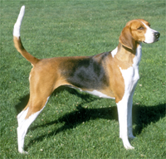
4. American Foxhound

Slide 6
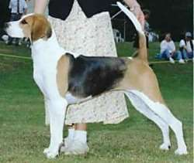
5. English Foxhound

Slide 7
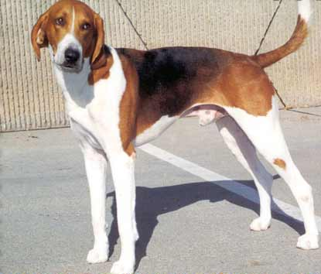
6. American Foxhound

Slide 8
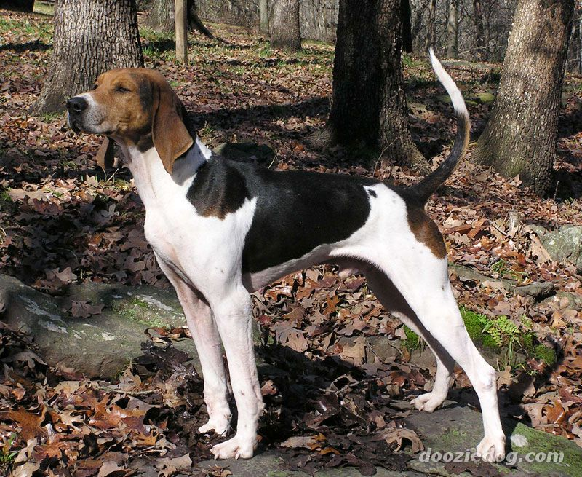
7. American Foxhound

Slide 9
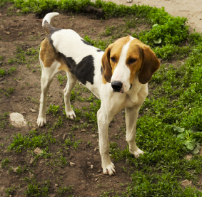
8. English Foxhound

Slide 10
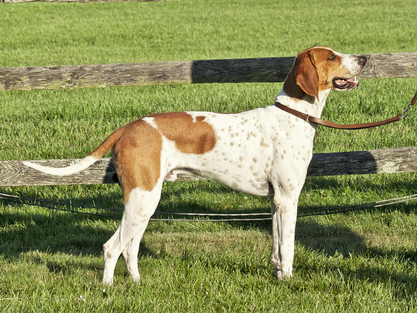
9. American Foxhound

Slide 11
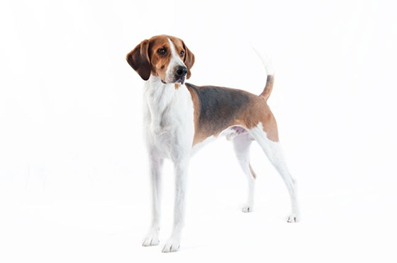
10. English Foxhound

Slide 12
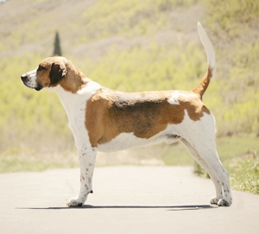
11. English Foxhound

Slide 13
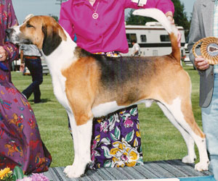
12. American Foxhound

Slide 14
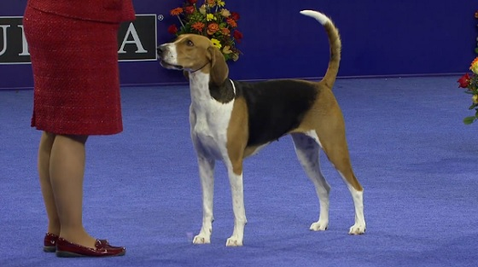
13. American Foxhound

Slide 15
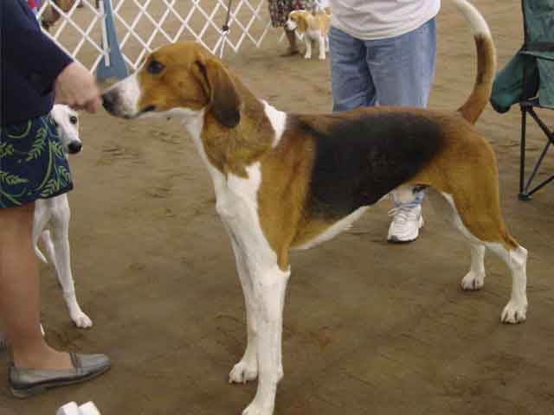
14. English Foxhound

Slide 16
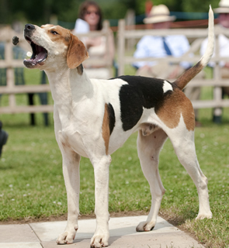
15. American Foxhound

Slide 17
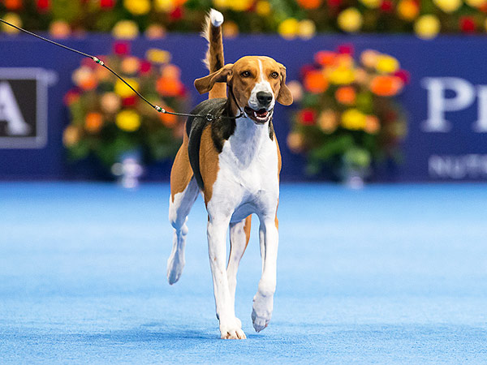
16. American Foxhound

Slide 18
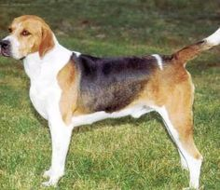
17. English Foxhound

Slide 19
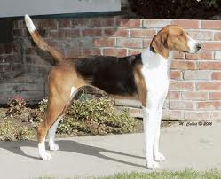
18. American Foxhound

Slide 20
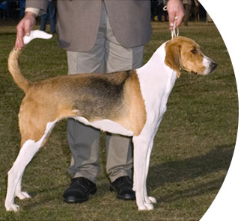
19. American Foxhound

Slide 21
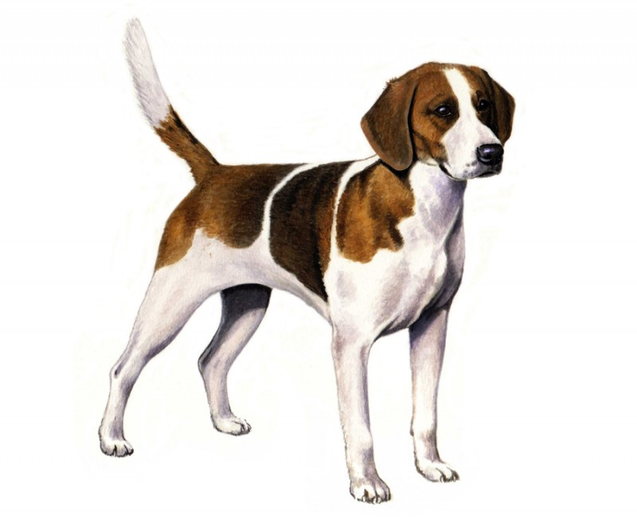
20. English Foxhound

Slide 22
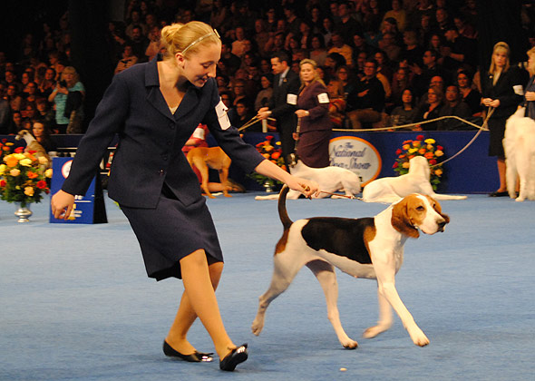
21. English Foxhound

Slide 23
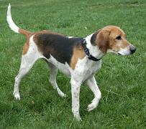
22. American Foxhound

Slide 24
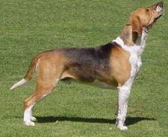
23. English Foxhound

Slide 25
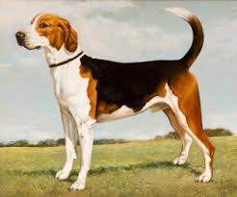
24. English Foxhound

Slide 26
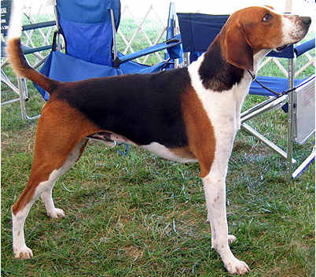
25. American Foxhound

