Slide 1
Specialty Animal Judging
General Knowledge Information
Dog, Cat, Rabbit, Goats, Cavies, Rats, Hamsters

Slide 2
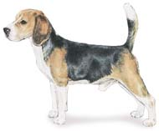
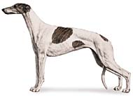
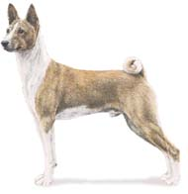
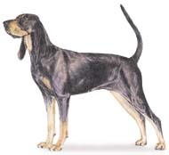
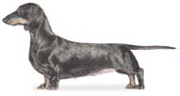
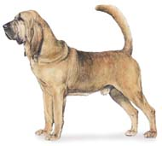
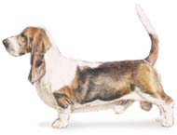
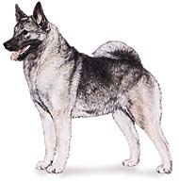
Dog Breeds
AFGHAN
HOUNDS
BASENJI
BEAGLE
GREYHOUND
DACHSHUND
BASSETT
BLACK AND TAN COONHOUND
NORWEGIAN ELKHOUND
BLOODHOUND

Slide 3
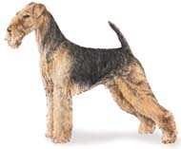
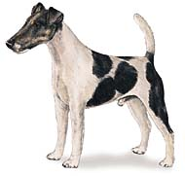
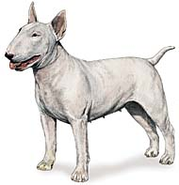
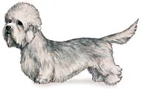
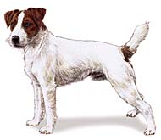
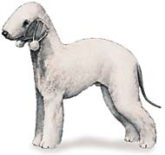
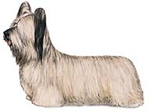
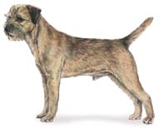
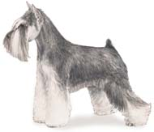
Dog Breeds
AIRDALE
TERRIERS
BULL TERRIER
BEDLINGTON
FOX TERRIER
DANDY DINMONT TERRIER
BORDER TERRIER
PARSON JACK RUSSELL
MINATURE SCHNAUZER
SKYE TERRIER

Slide 4
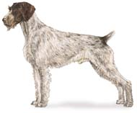
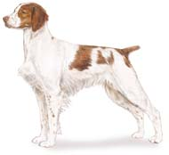
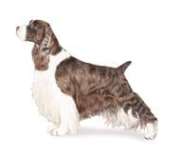
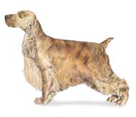
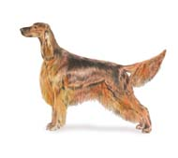
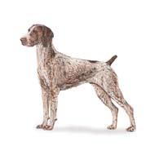
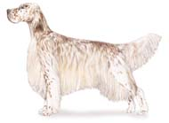
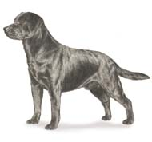
Dog Breeds
SPORTING
BRITTANY SPANIEL
ENGLISH COCKER SPANIEL
GERMAN WIREHAIRED POINTER
ENGLISH SPRINGER SPANIEL
ENGLISH SETTER
IRISH SETTER
GERMAN SHORTHAIRED POINTER
LABRADOR RETRIEVER

Slide 5
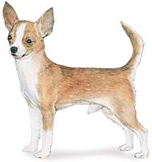
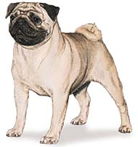
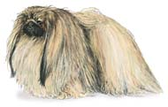
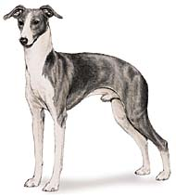
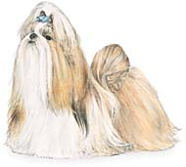
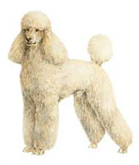
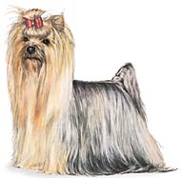
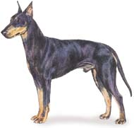
Dog Breeds
CHIHUAHUA
TOY
ITALIAN GREYHOUND
PEKINGESE
PUG
SHIH TZU
MANCHESTER TERRIER
POODLE (TOY)
YORKSHIRE TERRIER

Slide 6
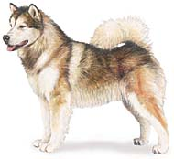
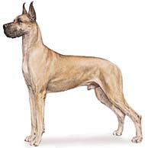
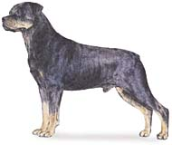
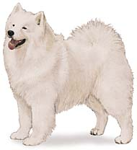
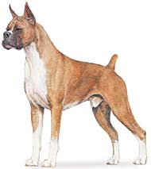
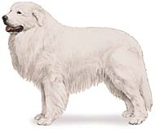
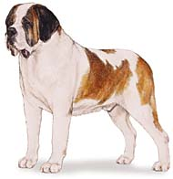
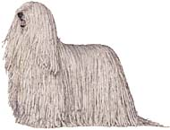
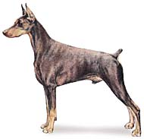
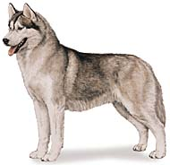
Dog Breeds
ALASKAN MALAMUTE
WORKING
BOXER
GREAT DANE
ROTTWEILER
SAMOYED
DOBERMAN PINSCHER
KOMODOR
GREAT PYRENEES
ST. BERNARD
SIBERIAN HUSKY

Slide 7
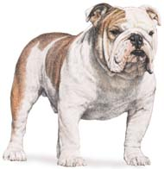
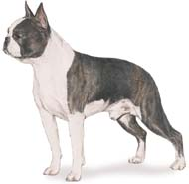
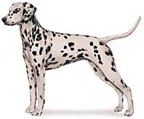
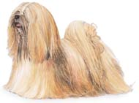
Dog Breeds
ENGLISH BULLDOG
NON SPORTING
DALMATIAN
BOSTON TERRIER
LHASA APSO
POODLE(MINITURE/STANDARD

Slide 8
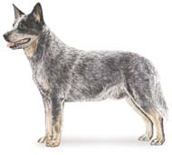
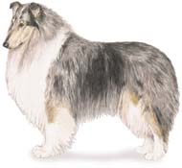
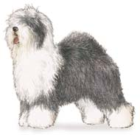
Dog Breeds
AUSTRALIAN CATTLE DOG
HERDING
AUSTRALIAN SHEPHERD
COLLIE
OLD ENGLISH SHEEPDOG
BORDER COLLIE
SHETLAND SHEEPDOG
GERMAN SHEPHERD
WELSH CORGI

Slide 9
CAT Breeds
ABYSSINIAN
BURMESE
AMERICAN SHORTHAIR
BOMBAY
CYMRIC
BALINESE
BRITISH SHORTHAIR
KORAT

Slide 10
CAT Breeds
Main Coon Cat
Manx
Siamese
Russian Blue
Egyptian Mau
Persian
Scottish Fold
Havana Brown

Slide 11
CAT Breeds
Tonkinese
Japanese Bobtail
Turkish Angora
Somali

Slide 12
Goat Breeds
Alpine
La Mancha
Pygmy Goat
Saanan
Nubian
Toggenburg

Slide 13
Cavy Breeds
Peruvian
Crested
Abyssinian
Teddy
American

Slide 14
Rat Breeds
Long-Evans Hooded
Standard
Rex

Slide 15
Hamster Breeds
Chinese
Teddy
Syrian

